Slide 1
Week 05

Slide 2
Updates
Present:
$ curl wttr.in
More $ history usage:
https://www.thegeekstuff.com/2011/08/bash-history-expansion/
Quiz 9/23
Lab 04 live, due 9/27
Lab 03 - late turn ins through Thursday, 9/23

Slide 3
Commands so far
man
ls
cat
vim
history
cd
pwd
touch
mkdir
rmdir
cp
mv
chmod
chown
chgrp
git clone
git add
git commit
git push
* vs . vs ..
printenv
echo
which
whereis
alias
history
sort
uniq
|
> vs >> vs <
if statements
test / [
regex

Slide 4
Package manager
$ apt
List of all official package repositories (apt install-able software)
$ sudo apt update
Updates list of available packages
$ sudo apt upgrade
Upgrades all packages that have new versions
$ sudo apt install package_name
Installs package (if it is in package repositories)

Slide 5
What is this thing I’m using?
$ type what_is_this
Displays the type of a command, alias, etc.
Does not work on files and folders
cd, aws-2350, ls, type
$ apropos thing_you_want_to_do
Shows some command suggestions and what they do (memory jogger)
Keyword search of command definitions
edit, directory, make

Slide 6
It was here a minute ago…
$ locate filename
Locate uses a database of files - it is not always up to date
$ find [where to start searching from] [expression determines what to find] [-options] [what to find]
By name
$ find ~ -name sample.txt
By size
By type
By permission
$ find ~ -perm 664
https://linuxize.com/post/how-to-find-files-in-linux-using-the-command-line/

Slide 7
Class plays regex
https://regexone.com/lesson/introduction_abcs
Walking through usage lessons 1-10
Left off on [a-z][A-Z][0-9]
Fun testing site:
https://regex101.com/

Slide 8
Grep + Regex
Grep – print lines matching a pattern
$ grep [Options] ‘pattern_here’ file_name
/usr/share/dict/words – contains a lot of words
-E flag – boosts regular expressions
Enables {}, +, etc.
So if it isn’t working, try E flag
egrep == grep -E
Notes:
https://www.digitalocean.com/community/tutorials/using-grep-regular-expressions-to-search-for-text-patterns-in-linux

Slide 9
Word count
$ wc filename
Prints lines, words, and bytes
$ ls /bin /usr/bin | sort | uniq | wc -l

Slide 10
QUIZ TODAY!
Open until 11:59 PM
2 attempts available

Slide 11
Path Finder
Path and path

Slide 12
So far
Scripts can be sourced
Scripts can be given execute permissions, and run with ./
But what if you want the command to be accessible anywhere, not just from one spot?

Slide 13
Stuff in the Shell
$ printenv
All environment variables
$ printenv VAR_NAME - print only the specifyied value
$ set | less
Shows are set variables for the environment & shell, + shell functions
$ alias
Shows all aliases

Slide 14


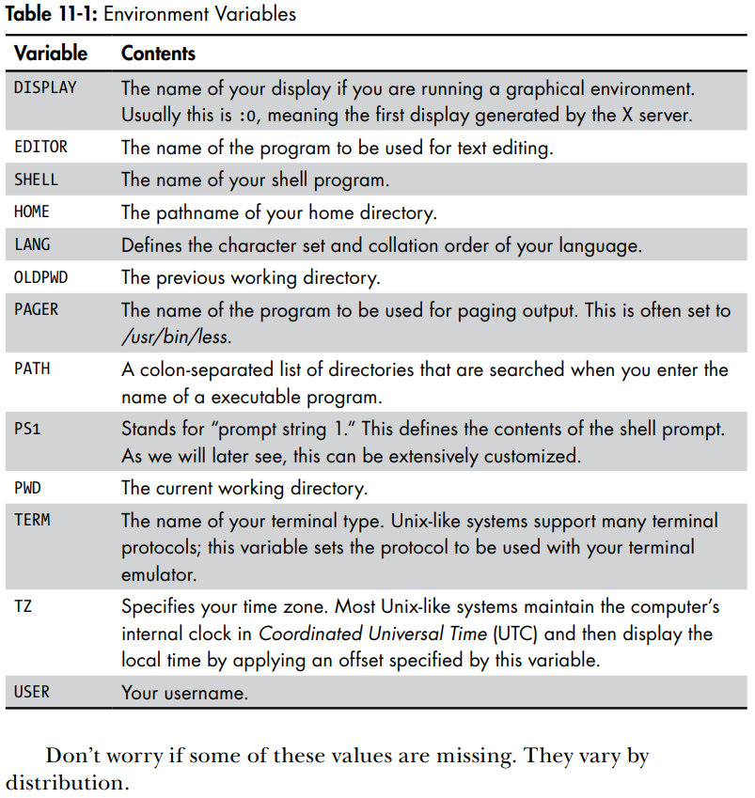



Common Env Vars

Slide 15
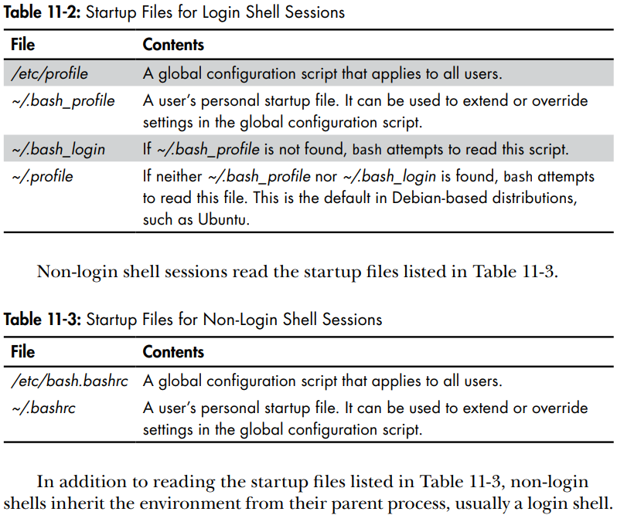
Startup Files

Slide 16
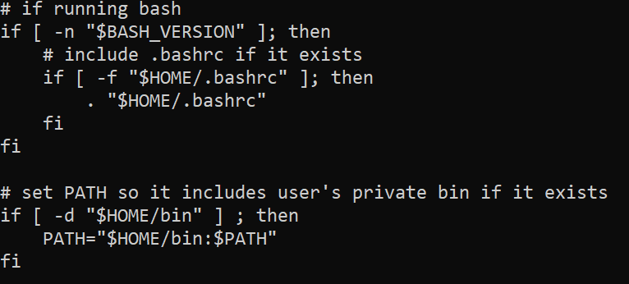
Peek at .profile
PATH hold folders where programs & scripts can be run by name
.profile holds configs once we have logged in to a shell session
Is there somewhere we could store scripts to run by name?

Slide 17
Modifying PATH
echo $PATH – prints the value of PATH to terminal
PATH is a series of directories the environment uses to find a command
‘export’ is a command that modifies environment variables (Linux)
Set to every time your shell logs in by adding to .profile
Use echo to check format before making permanent
Notes:
https://opensource.com/article/17/6/set-path-linux

Slide 18
PATH mess ups
It’s okay!
Disconnect from your AWS system, reconnect via ssh
The export command (before you add it to .profile) is temporary for the shell you are in

Slide 19
Exercise
Create a directory called demos
Create a script that echos “You found me!” called korrok
Make sure korrok is executable
Add the demos directory to PATH

Slide 20
Bash Scripting Crash Course
You may be using these through the rest of the labs

Slide 21
Read in content
Sure you can pass in info with arguments
But getting user input is still nice
read variablename
Command that stores content in the variable
Much like any code, you should maybe prompt the user…
Try using: read -s
https://linuxize.com/post/bash-read/

Slide 22
Single quotes
Enclosing characters in single quotes (‘'’) preserves the literal value of each character within the quotes. A single quote may not occur between single quotes, even when preceded by a backslash.
$ echo ‘$test’
Vs
$ echo “$test”
Notes:
https://www.gnu.org/software/bash/manual/html_node/Single-Quotes.html
https://www.geeksforgeeks.org/difference-between-single-and-double-quotes-in-shell-script-and-linux/

Slide 23
Double quotes
Double quotes (‘"’) preserves the literal value of all characters within the quotes, with the exception of ‘$’, ‘`’, ‘\’, and, when history expansion is enabled, ‘!’
So…
For a print statement in which you are going to print a variable, you need to put it in double quotes:
$ printf “My variable output is $var"
Notes:
https://www.gnu.org/software/bash/manual/html_node/Double-Quotes.html
https://www.geeksforgeeks.org/difference-between-single-and-double-quotes-in-shell-script-and-linux/

Slide 24
Backticks (and $ parens)
Or the grave accent?
Backticks stand for command substitution
$ file_count=`ls | wc -l`
$ echo "There are $file_count files in this directory"
There is a better way:
$ echo "There are $(ls | wc -l) files in this directory"
Instead of backticks use $ parens
Notes:
https://www.redhat.com/sysadmin/backtick-operator-vs-parens

Slide 25
While loops
while command
do
Statement(s) to be executed if command is true
done
#!/bin/sh
a=0
while [ $a -lt 10 ]
do
echo $a
a=`expr $a + 1`
done
Notes:
https://www.tutorialspoint.com/unix/while-loop.htm
https://www.redhat.com/sysadmin/bash-scripting-while-loops
https://www.cyberciti.biz/faq/bash-while-loop/
https://tldp.org/LDP/Bash-Beginners-Guide/html/sect_09_02.html
https://tldp.org/HOWTO/Bash-Prog-Intro-HOWTO-7.html
https://linuxize.com/post/bash-while-loop/

Slide 26
For loops
Exciting news - they auto iterate
for item in [LIST]
do
[COMMANDS]
done
for element in Hydrogen Helium Lithium Beryllium
do
echo "Element: $element"
done
Notes:
https://linuxize.com/post/bash-for-loop/
https://www.redhat.com/sysadmin/bash-scripting-loops
https://www.cyberciti.biz/faq/bash-for-loop/

Slide 27
Looping through file lines
For loops work on list of inputs.
You could think of a file as a return character separated list
$ cat filename
Prints contents of a file, but really it prints LINES of a file
for line in $(cat filename)
do
echo $line
done
Notes:
https://codefather.tech/blog/bash-loop-through-lines-file/

Slide 28
Note on for loops
You can get your iterator back if you are sad
for ((INITIALIZATION; TEST; STEP))
do
[COMMANDS]
done
for ((i = 0 ; i <= 1000 ; i++)); do
echo "Counter: $i"
done
Notes:
https://linuxize.com/post/bash-for-loop/

Slide 29
Intro to `grep`
grep searches the named input FILEs (or standard input if no files are named, or if a single hyphen-minus (-) is given as file name) for lines containing a match to the given PATTERN.
By default, grep prints the matching lines.
`man grep` - what other options might be useful?
https://www.tutorialspoint.com/unix_commands/grep.htm
https://www.opensourceforu.com/2012/06/beginners-guide-gnu-grep-basics/

Slide 30
Grep + Regex
Grep – print lines matching a pattern
$ grep [Options] ‘pattern_here’ file_name
/usr/share/dict/words – contains a lot of words
-E flag – boosts regular expressions
Enables {}, +, etc.
So if it isn’t working, try E flag
egrep == grep -E
Notes:
https://www.digitalocean.com/community/tutorials/using-grep-regular-expressions-to-search-for-text-patterns-in-linux

Slide 31
Intro to `sed`
SED command in UNIX is stands for stream editor and it can perform lot’s of function on file like, searching, find and replace, insertion or deletion. Though most common use of SED command in UNIX is for substitution or for find and replace. By using SED you can edit files even without opening it, which is much quicker way to find and replace something in file, than first opening that file in VI Editor and then changing it.
SED is a powerful text stream editor. Can do insertion, deletion, search and replace(substitution).
SED command in unix supports regular expression which allows it perform complex pattern matching.
Notes:
https://www.cyberciti.biz/faq/how-to-use-sed-to-find-and-replace-text-in-files-in-linux-unix-shell/
https://www.geeksforgeeks.org/sed-command-in-linux-unix-with-examples/
https://www.grymoire.com/Unix/Sed.html

Slide 32
sed example
$ sed 's/unix/linux/g' geekfile.txt
s = search
unix is the search phrase. linux is the replace phrase
g = global (replace all instances)
$ echo "Welcome To The Geek Stuff" | sed 's/\(\b[A-Z]\)/\(\1\)/g’
Save with output redirection OR by using the -i option (which will svae the result to the input file

Slide 33
Intro to `awk`
AWK is an interpreted programming language
Myriad of tasks can be done with AWK. Listed below are just a few of them −
Text processing,
Producing formatted text reports,
Performing arithmetic operations,
Performing string operations, and many more.
Notes:
https://www.geeksforgeeks.org/awk-command-unixlinux-examples/
https://www.tutorialspoint.com/awk/index.htm
https://www.grymoire.com/Unix/Awk.html

Slide 34
Awk Examples
ajay manager account 45000
sunil clerk account 25000
varun manager sales 50000
amit manager account 47000
tarun peon sales 15000
deepak clerk sales 23000
sunil peon sales 13000
satvik director purchase 80000
$ awk '{print $1,$4}' employee.txt

Slide 35
In summary
Grep is find
Sed is find and replace
AWK can do a ton more, such as parse line separators and store them in a variable, then you can access them like an array

Slide 36
Note on Lab 04
Part 3 has two goals:
Find a regular expression that matches emails
Find a tool that will give you the result you want
As a hint, I went with egrep and had egrep only show matching output, not that whole line that matched
This is only a hint, not a requirement.

Slide 37
In class scripts 9/23
https://github.com/pattonsgirl/Fall2021-CEG2350/tree/main/scripts

